Slide 1
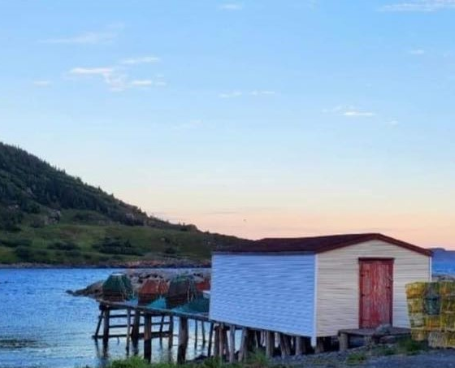
CFG- WEB DESIGN PROJECT: Ecommerce website design
Group 9: Angela Brown , Izzy Lavery, Pratyusha Pabolu
Notes:
NOTE:
To change the image on this slide, select the picture and delete it. Then click the Pictures icon in the placeholder to insert your own image.

Slide 2
Index
About the project
Wireframe/Design
Website Screens
Project Repositories
Thank you

Slide 3


About the project
Introduction
The project is to design an ecommerce website for an online store selling bath and beauty products
Client
Our client Beneath The Fog, where the essence of Connaigre Bay meets craftsmanship, care, and family tradition. Established in 2021 by the visionary Crewe Harris sisters, Brenda and Pamela, our journey began amidst the serene shores of Hermitage-Sandyville, Newfoundland.
Requirements
Our client’s requirement is to build an ecommerce website to showcase their products and allow users to select products and place orders. Users should be able to register and then login to their account to purchase the products.
Home page should have major product line, links to products, events, about us, login and sign up screens

Slide 4
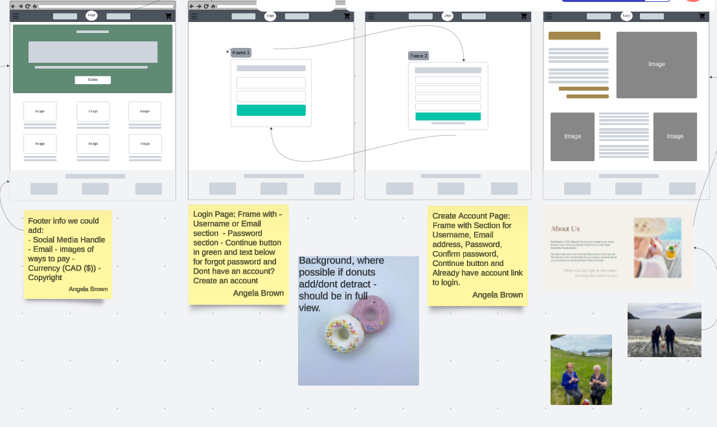
Wire Frame & Design
Technology/Frameworks
HTML, CSS, Javascript
Bootstrap 5
Visual studio Code
Git, Git Desktop
Team
Angela Brown
Izzy Lavery
Pratyusha Pabolu
Lucidspark

Slide 5
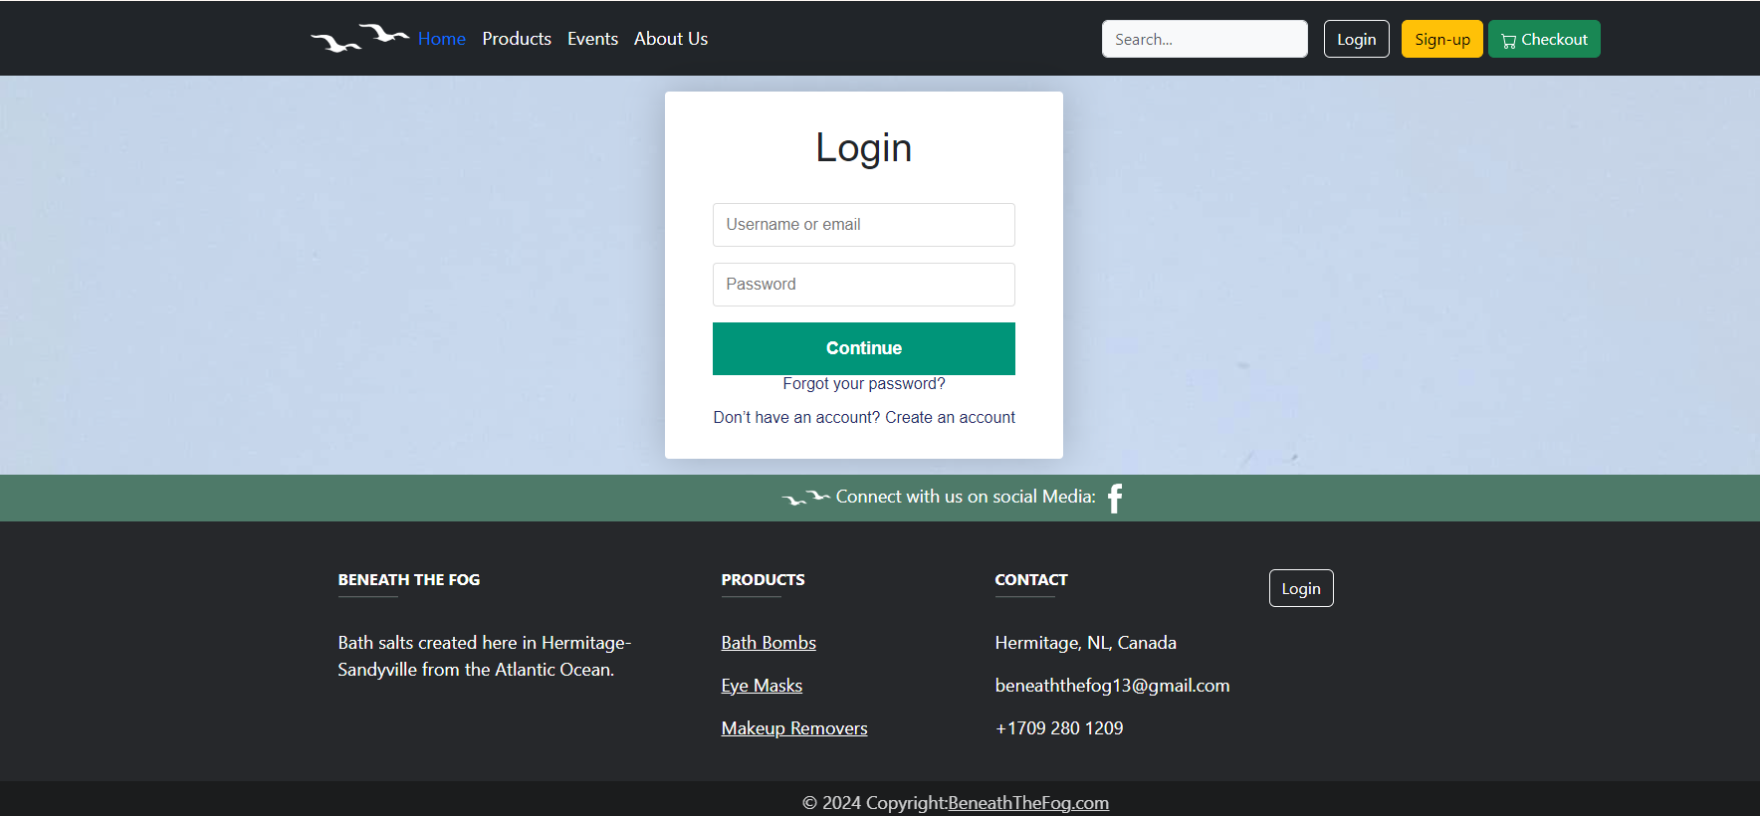
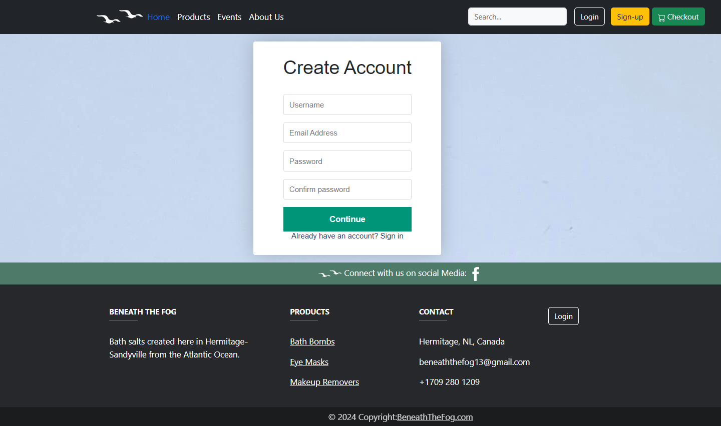
Website Screens – Login/Signup users

Slide 6
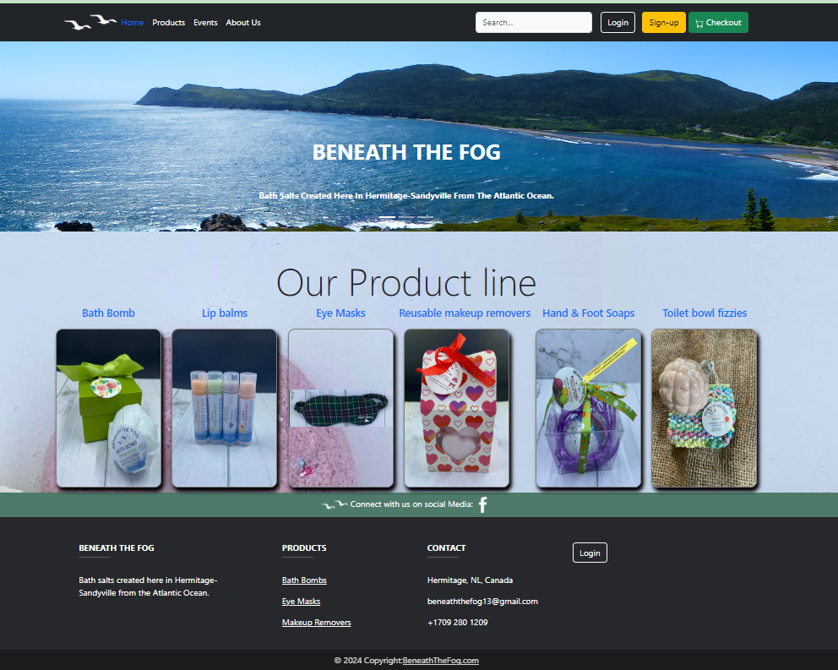
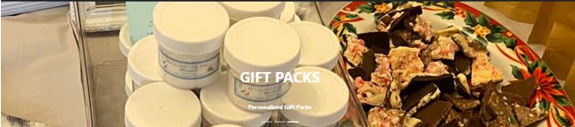

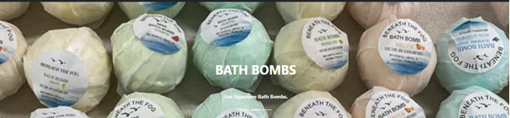
Website Screens – Home page

Slide 7
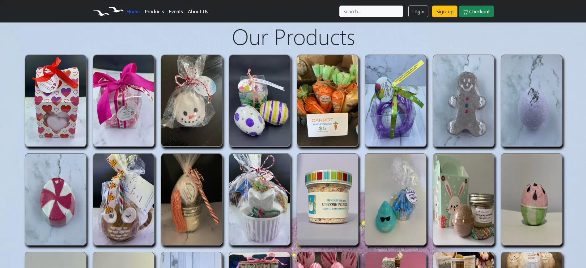
Website Screens – Products page

Slide 8
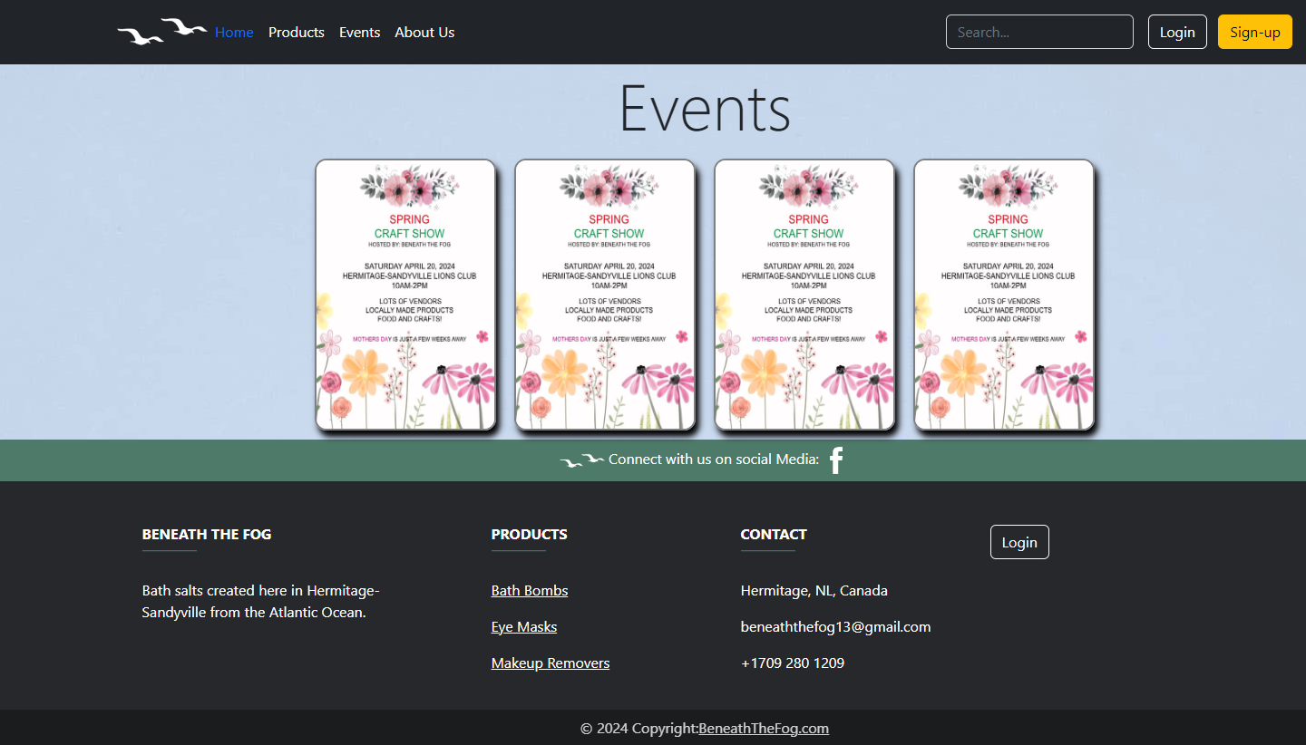
Website Screens – Events

Slide 9
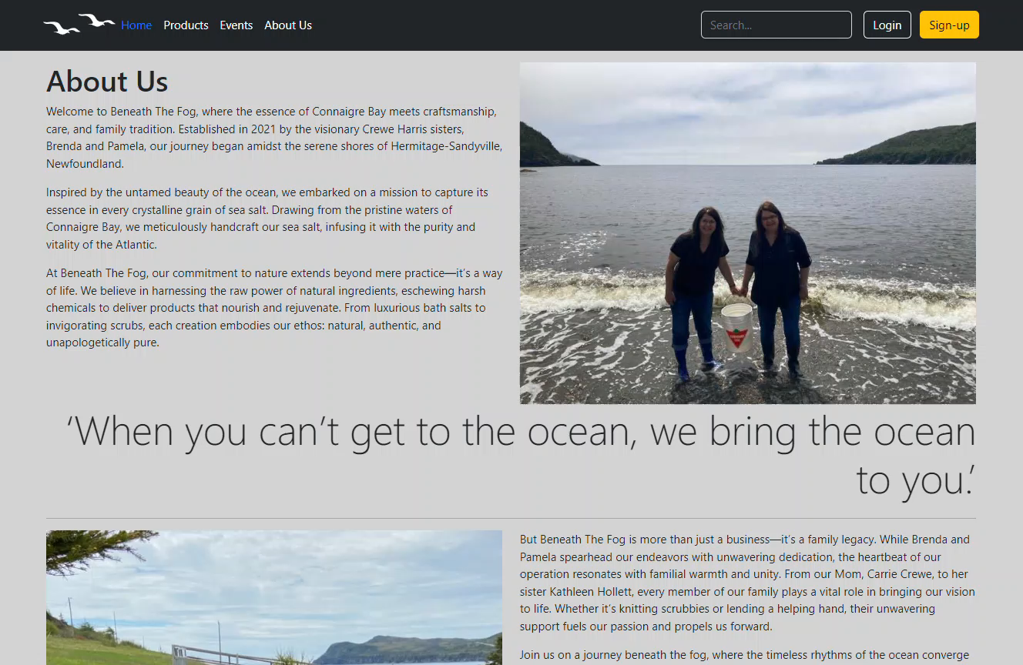
Website Screens – About Us Screens

Slide 10


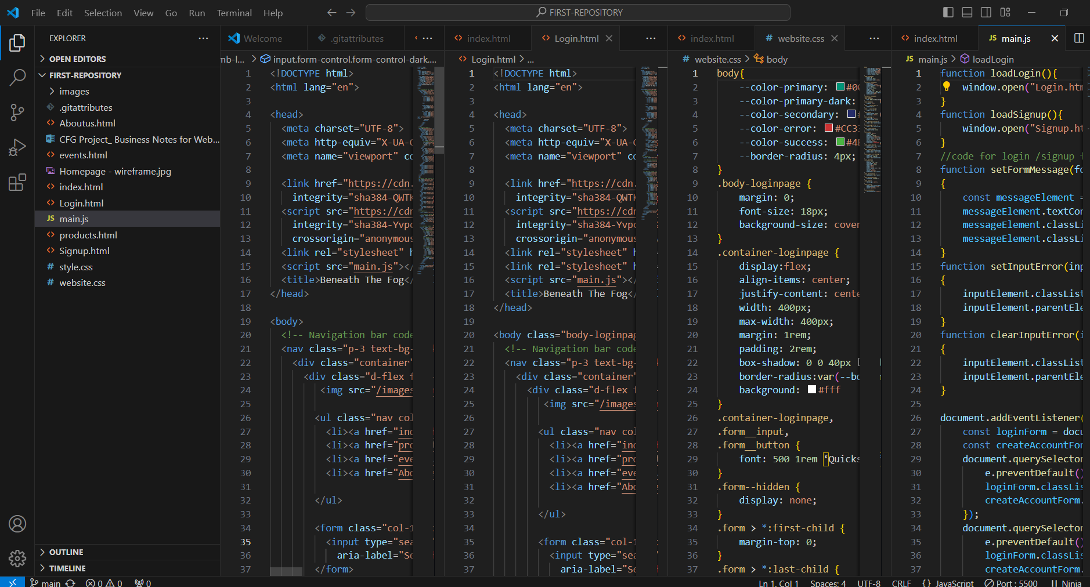
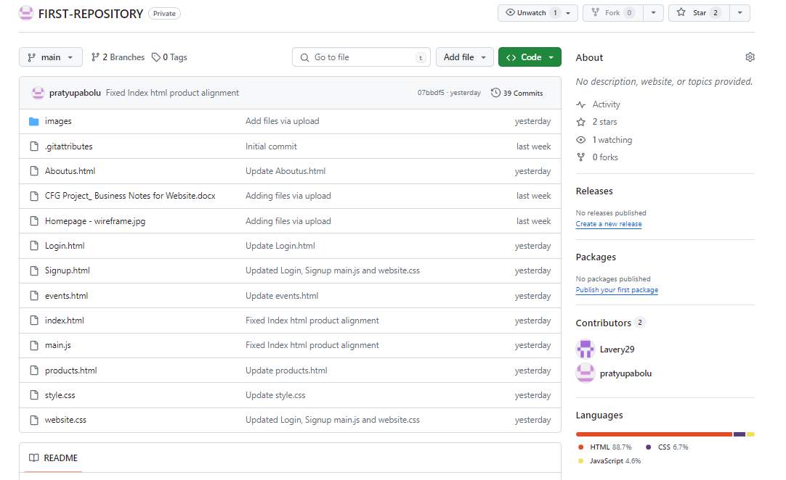
Project Repositories
Project Structure
Github Repository
https://github.com/pratyupabolu/FIRST-REPOSITORY

Slide 11
Thank you
Group 9: Angela Brown, Izzy Lavery,
Pratyusha Pabolu

